Slide 1
CFG Data & SQL Travel Itinerary Database Project
By Holly Carruthers

Slide 2
Project Overview
My database design allows for managing and analysing travel itineraries, activities, and user reviews, providing insights into user preferences and destination popularity.

Slide 3
Table Overview
Users Table: This table stores information about users, including their unique user ID, first name, last name, and email address.
Destinations Table: Contains details about various travel destinations, such as the destination ID, name, country, and attractions.
Itineraries Table: This table records planned itineraries for users, including the itinerary ID, user ID, destination ID, start date, and end date. It establishes relationships between users and destinations.
Activities Table: Stores details about activities planned within each itinerary, including the activity ID, itinerary ID, activity name, description, location, date, and time.
Reviews Table: This table tracks reviews provided by users for specific activities, storing information such as review ID, user ID, destination ID, activity ID, and rating.

Slide 4
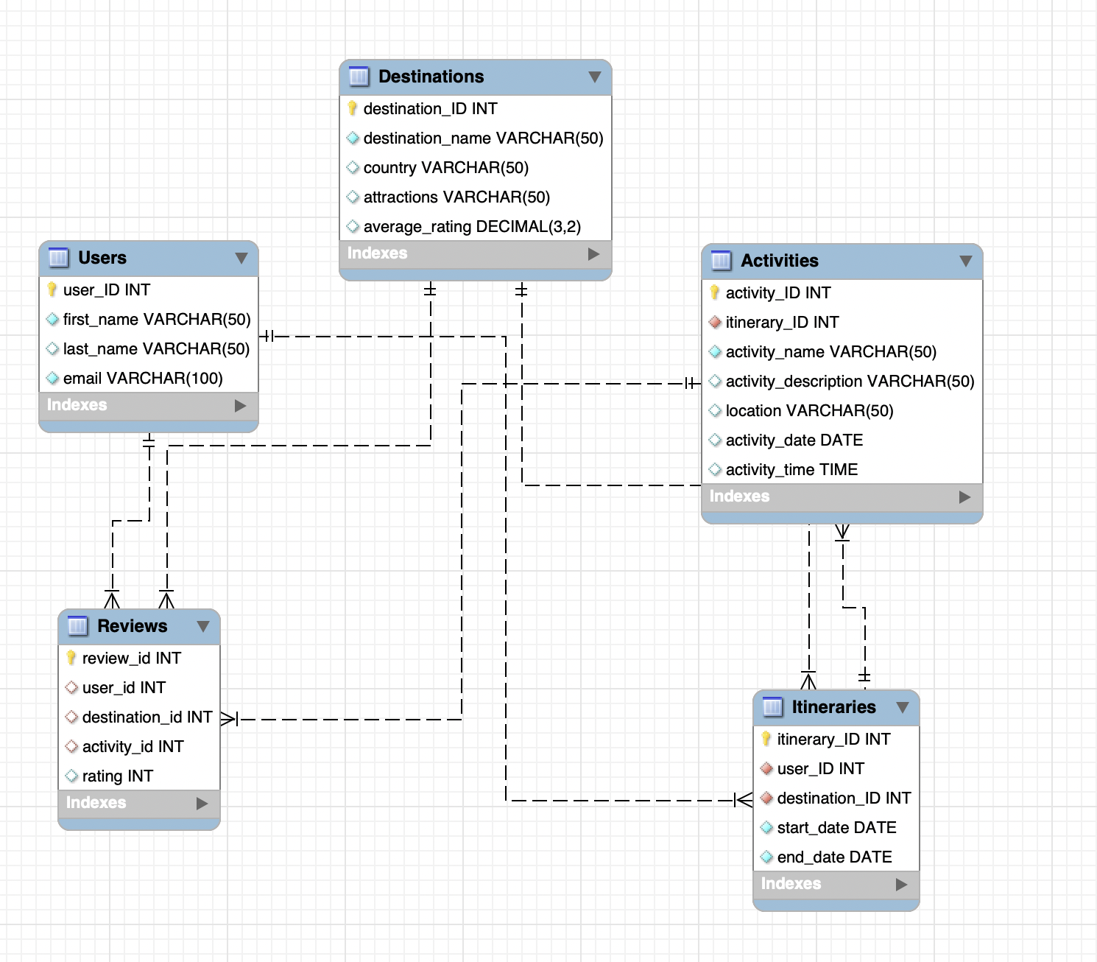

Slide 5
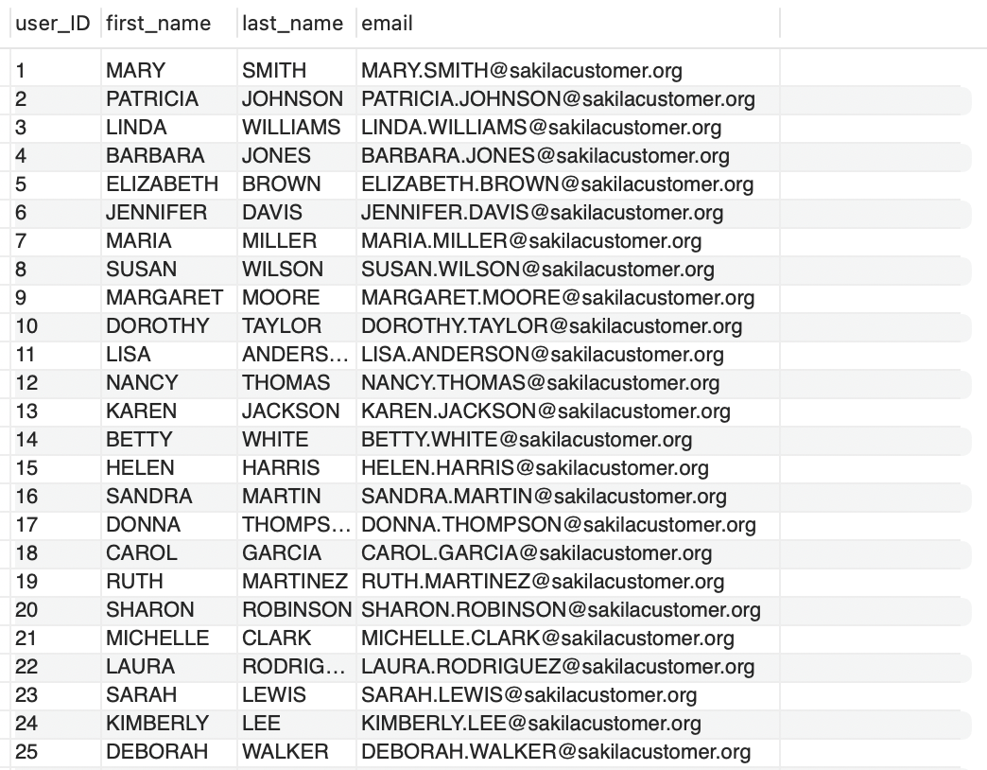
Users Table
This table stores information about users, including their unique user ID, first name, last name, and email address.

Slide 6
Users Table
Primary Key Constraint: The user_ID column is designated as the primary key, ensuring each user has a unique identifier.
This table stores information about users, including their unique user ID, first name, last name, and email address.

Slide 7
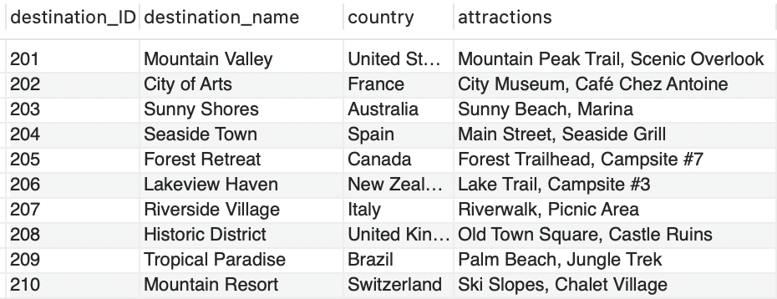
Destinations Table
Contains details about various travel destinations, such as the unique destination ID, destination name, country, and attractions.

Slide 8
Destinations Table
Primary Key Constraint: The destination_ID column acts as the primary key, ensuring uniqueness for each destination.
Contains details about various travel destinations, such as the unique destination ID, destination name, country, and attractions.

Slide 9
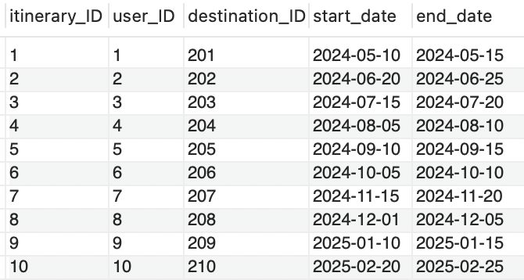
Itinerary Table
This table records planned itineraries for users, including the itinerary ID, user ID, destination ID, start date, and end date.

Slide 10
Itinerary Table
Primary Key Constraint: The itinerary_ID column is designated as the primary key, ensuring each itinerary has a unique identifier.
This table records planned itineraries for users, including the itinerary ID, user ID, destination ID, start date, and end date.

Slide 11
Itinerary Table
This table records planned itineraries for users, including the itinerary ID, user ID, destination ID, start date, and end date.
Foreign Key Constraint: The user_ID column references the user_ID column in the Users table, establishing a relationship between users and their itineraries.

Slide 12
Itinerary Table
Foreign Key Constraint: The destination_ID column references the destination_ID column in the Destinations table, linking itineraries to specific destinations
This table records planned itineraries for users, including the itinerary ID, user ID, destination ID, start date, and end date.

Slide 13
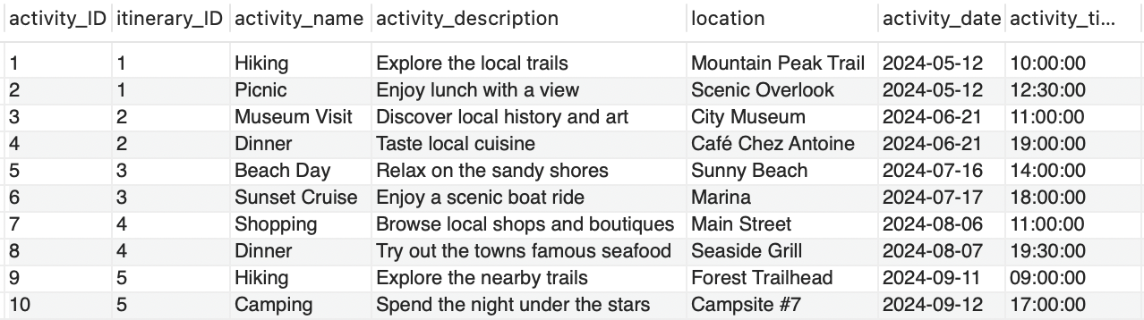
Activities Table
Stores details about activities planned within each itinerary, including the activity ID, itinerary ID, activity name, description, location, date, and time.

Slide 14
Activities Table
Primary Key Constraint: The activity_ID column serves as the primary key, ensuring each activity has a unique identifier.
Stores details about activities planned within each itinerary, including the activity ID, itinerary ID, activity name, description, location, date, and time.

Slide 15
Activities Table
Foreign Key Constraint: The itinerary_ID column references the itinerary_ID column in the Itineraries table, establishing a relationship between activities and their corresponding itineraries
Stores details about activities planned within each itinerary, including the activity ID, itinerary ID, activity name, description, location, date, and time.

Slide 16
Activities Table
Stores details about activities planned within each itinerary, including the activity ID, itinerary ID, activity name, description, location, date, and time.

Slide 17
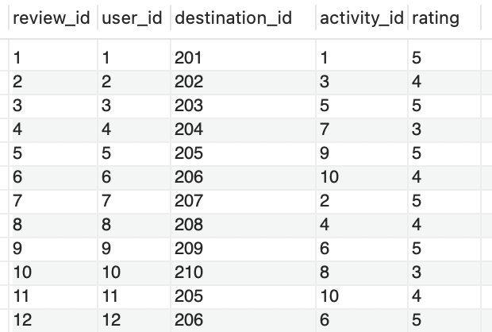
Reviews Table
This table tracks reviews provided by users for specific activities, storing information with a unique review ID, user ID, destination ID, activity ID, and rating.

Slide 18
Reviews Table
Primary Key Constraint: The review_ID column acts as the primary key, ensuring each review has a unique identifier.
This table tracks reviews provided by users for specific activities, storing information with a unique review ID, user ID, destination ID, activity ID, and rating.

Slide 19
Reviews Table
Foreign Key Constraint: The user_ID column references the user_ID column in the Users table, linking reviews to specific users
This table tracks reviews provided by users for specific activities, storing information with a unique review ID, user ID, destination ID, activity ID, and rating.

Slide 20
Reviews Table
Foreign Key Constraint: The destination_ID column references the destination_ID column in the Destinations table, connecting reviews to specific destinations
This table tracks reviews provided by users for specific activities, storing information with a unique review ID, user ID, destination ID, activity ID, and rating.

Slide 21
Reviews Table
Foreign Key Constraint: The activity_ID column references the activity_ID column in the Activities table, establishing a relationship between reviews and the activities they pertain to.
This table tracks reviews provided by users for specific activities, storing information with a unique review ID, user ID, destination ID, activity ID, and rating.

Slide 22
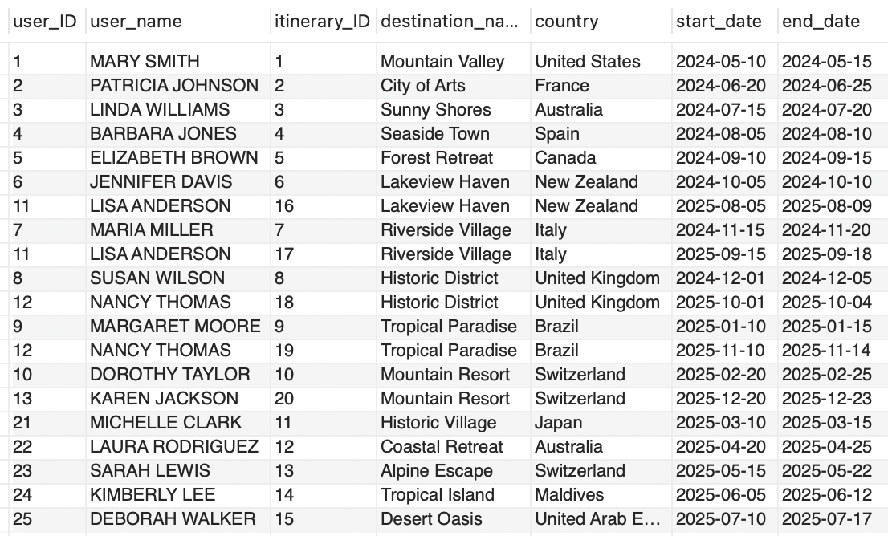
“Use Joins to create a view that combines multiple tables in a logical way”
I have created a view named Itinerary_Details combining information from Users, Itineraries, and Destinations tables to show which users have created which itineraries for which destinations.
Notes:
In this view, I have selected information about users ('Users' table), itineraries ('Itineraries' table), and destinations ('Destinations' table). I joined these tables based on the foreign key relationships between them ('user_ID' in 'Users', 'itinerary_ID' in Itineraries, and 'destination_ID' in Destinations)
The 'CONCAT' function is used to concatenate the 'first_name' and 'last_name' columns from the 'Users' table to display the full name of the user
This view provides a concise overview of which users have created which itineraries for which destinations, making it easier to analyse and manage itinerary details

Slide 23
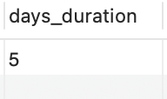
“Create a stored function that can be applied to a query in your Database”
I created a stored function ‘Calculate_Duration’ which allows you to calculate the duration of a User’s itinerary based on the provided start and end dates
Notes:
The DELIMITER command is used to change the delimiter from ; to // temporarily. This is necessary because the function definition contains ; within it, and changing the delimiter prevents conflicts.
The CREATE FUNCTION statement defines a new stored function named Calculate_Duration that takes two parameters: start_date and end_date.
DETERMINISTIC keyword after the RETURNS INT line:This indicates that the function always produces the same result for the same input parameters, which satisfies the requirements for binary logging.
Within the function body, we declare a variable duration of type INT.
We then calculate the duration by subtracting the start_date from the end_date using the DATEDIFF function, which returns the difference in days between two dates.
Finally, we return the calculated duration.

Slide 24
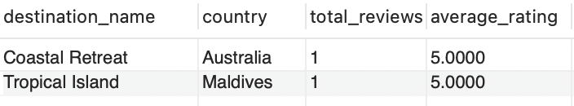
”Prepare an example query with a subquery to demonstrate how to extract data from your DB for analysis”
I created a subquery to retrieve the list of destinations with the highest average rating, including the total number of reviews and the average rating for each destination.
Notes:
The outer query selects the destination name, country, total number of reviews, and average rating for each destination from the 'Destinations' table
It joins the 'Destinations' table with the 'Reviews' table using a LEFT JOIN to include destinations even if they have no reviews
The results are grouped by destination name and country
The HAVING clause filters the results to only include destinations where the average rating matches the maximum average rating calculated by the subquery
The subquery calculates the average rating for each destination using the Reviews table and then selects the maximum average rating among all destinations
This query will give you the list of destinations with the highest average rating, along with the total number of reviews and the average rating for each destination.

Slide 25

”Create a DB diagram where all table relations are shown”

Slide 26
Advanced Requirements

Slide 27
“Create a stored procedure and demonstrate how it runs”
I have implemented a Stored Procedure that retrieves itinerary details for a specific user based on the provided user_ID
When the stored procedure is called and the user ID is passed as an argument, it will execute the SELECT query and return the relevant itinerary details for that user.
This simplifies the process of retrieving itinerary details for a specific user.
Notes:
CREATE PROCEDURE: This statement creates a new stored procedure named GetUserItineraries. It takes one input parameter userId
SELECT statement: Within the procedure, the SELECT query retrieves itinerary details for a specific user. The query joins the Users, Itineraries, Destinations, and Activities tables based on their relationships (user_ID, destination_ID, and itinerary_ID), filtering by the userId parameter.

Slide 29
Each row represents a specific activity planned for the user’s itinerary, including details such as the destination, dates, and activity specifics.
Here we see the information for Linda Williams and see she has two activities planned for her trip to Australia, a Beach Day and a Sunset Cruise.

Slide 31
Here we see the information for Michelle Clark and see she has two activities planned for her trip to Japan, a Shrine Visit and a Tea Ceremony

Slide 32
”Create a Trigger and demonstrate how it runs”
I have implemented a trigger that automatically updates the average rating of a destination or activity when a new review is added.
The trigger calculates and updates the average rating for each destination in the Destinations table whenever a new review is inserted into the Reviews table.
This mechanism ensures the average_rating column in the Destinations table stays up-to-date with the latest average ratings based on reviews.
Notes:
The trigger fires after an insertion operation (AFTER INSERT) on the Reviews table for each row (FOR EACH ROW).
Inside the trigger, a variable avg_rating of is declared to store the calculated average rating.
The trigger calculates the average rating for the destination associated with the newly inserted review by selecting the average rating from the Reviews table where the destination_ID matches the destination_ID of the newly inserted review.
Then, it updates the average_rating column of the Destinations table with the calculated average rating for the corresponding destination_ID.

Slide 33
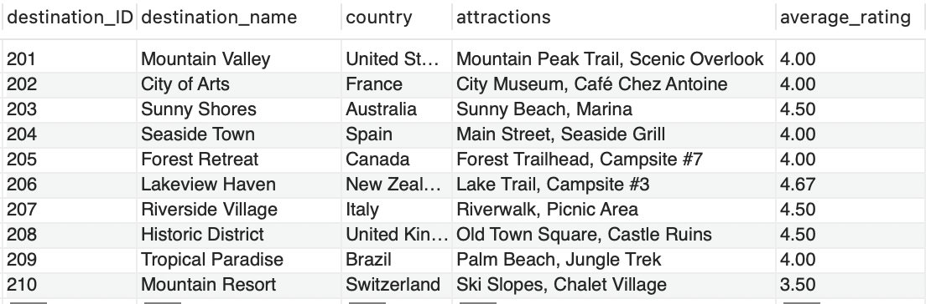
Here is the destination table with the average_rating column.

Slide 34
I am going to be adding a new review which references destination_ID 201

Slide 35
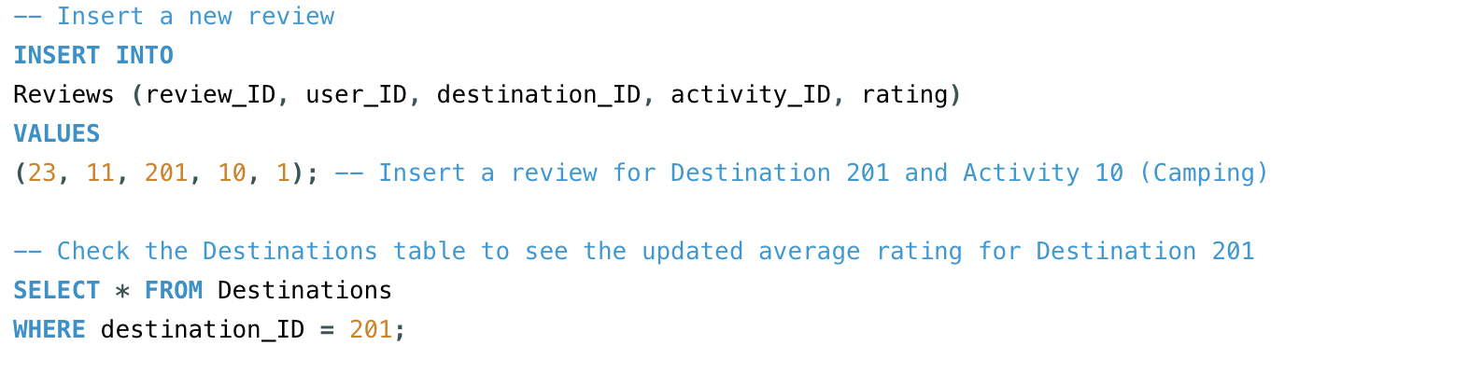

Slide 36
The average_rating column in the destinations table has been updated to create the new average rating based on the new values inserted into the reviews column.

Slide 37

”Create a view that uses at least 3-4 base tables; demonstrate a query that uses the view to produce a logically arranged result set for analysis”

Slide 38
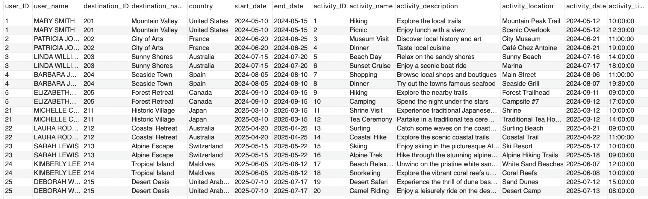
View Creation
I created a view Itinerary_Details2 that combines information from the Users, Itineraries, Destinations and Activities tables into a single logical structure to provide more comprehensive details about each user’s itinerary.

Slide 39
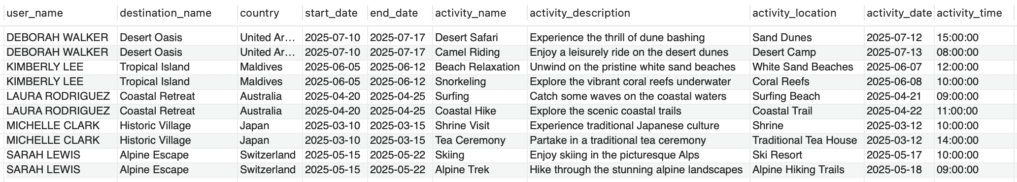
Query using view to produce logically arrange result set
In this query, I retrieve itinerary details from the Itinerary_Details2 view for all users whose itineraries fall within the year 2025.
I arranged the results by user name, the start date of the itinerary, activity date, and activity time, providing a logically arranged result set for analysis.

Slide 40
Thank you for listening!

